Slide 1
8th Grade Science
Chapter 11
Distance and Displacement

Slide 2
Learning Objectives
I can describe the difference between scalar and vector quantities.
I can determine displacement and distance using a scale diagram or calculation.
I can calculate the displacement of an object with two vector quantities in one direction or at right angles.

Slide 3
Physics Introduction
The motion of objects can be described by words. Even a person without a background in physics has a collection of words that can be used to describe moving objects. Words and phrases such as going fast, stopped, slowing down, speeding up, and turning provide a sufficient vocabulary for describing the motion of objects. In physics, we use these words and many more. We will be expanding upon this vocabulary list with words such as (but not limited to) distance, displacement, speed, velocity, and acceleration.

Slide 4
Scalars and Vectors
All physical quantities can be divided into two groups – scalers and vectors
When determining if a quantity is a vector or a scaler you need to ask 1 question, does direction matter?
Vector - quantity with both magnitude (size or numerical value) and direction
Scalar - quantity with magnitude (size or numerical
value) only

Slide 5
Examples of Scalars and Vectors
Vectors:
Displacement
Velocity
Acceleration
Momentum
Force
Scalars:
Distance
Speed
Time
Mass
Energy

Slide 6
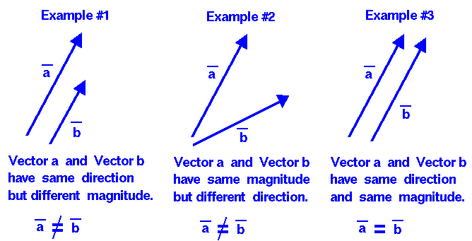
Vectors
Often represented by arrows.
Length of the arrow represents the magnitude (how far, how fast, how strong, etc. depending on the type of vector)

Slide 7
Do you know the difference?
Quantity | Category
5 m
30 m/sec, East
5 mi., North
20 degrees Celsius
256 bytes
4000 Calories
Scalar
Vector
Vector
Scalar
Scalar
Scalar

Slide 8
Distance
Distance (d) – how far an object travels or the length of a path between 2 points.
  Does not depend on direction.
  Scalar or vector quantity?
  Measured with a ruler or meter stick
What distance did the ant travel?
Scalar

Slide 9
Displacement
Displacement (Δx) –is the direction and the length of a straight line from the starting point to the ending point or where you are in relation to where you started from.
  Does depend on direction. Vector Quantity
Examples of directions:
  + and –
  N, S, E, W
  Angles

Slide 10
Distance and Displacement
Let’s visit our ant, and we we’ll find his distance and displacement.
Distance: 3 cm
Displacement: +3 cm
  The positive gives the ant a direction!
-
+
0
1
2
3
4
5
6
7
8
9
10
cm

Slide 11
Distance and Displacement
Find the ant’s distance and displacement again.
  Remember, displacement has direction!
Distance: 3 cm
Displacement: -3 cm
-
+
0
1
2
3
4
5
6
7
8
9
10
cm

Slide 12
Distance and Displacement
Find the distance and displacement of the ant.
Distance: 7 cm
Displacement: +3 cm
-
+
0
1
2
3
4
5
6
7
8
9
10
cm

Slide 13
Displacement and Distance in 2 Directions
You walk 3m east.
Than turn and go 4m North.
What is the distance of the walk?
Distance -
3m + 4m =
7m
4m North
3m East

Slide 14

Displacement and Distance in 2 Directions
You walk 3m east.
Than turn and go 4m North.
What is the displacement of the walk?
Displacement -
Pythagorean theory
A² + B² = C²
3² + 4² = C²
9 + 16 = C²
25 = C²
$√25$ = C
5m NE
4m North
5m North East
3m East

Slide 15
Displacement vs. Distance
Example of distance:
  The ant walked 3 cm.
Example of displacement:
  The ant walked 3 cm EAST.
An object’s distance traveled and its displacement aren’t always the same!

Slide 16
Distance vs. Displacement
You drive the path, and your odometer goes up by 8 miles (your distance).
Your displacement is the shorter directed distance from start to stop (green arrow).
start
stop

Slide 17
Distance and Displacement
What is the distance of the entire trip?
What is the displacement of the entire trip?
3 + 3 = 6 miles
0 miles

Slide 18
Distance and Displacement
160 + 120 + 80
= 360m
What is the distance of the entire trip?
What is the displacement of the entire trip?
120m East
Meters (m)

Slide 19
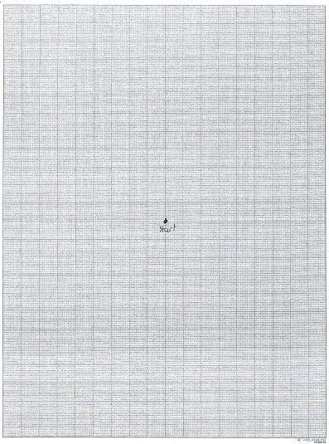
A
Distance start to A –
Total Distance –
Displacement -
11cm
11 cm
11cm
11cm N

Slide 20

B
7cm
A
Distance A to B –
Total Distance –
Displacement - A² + B² = C²
7² + 11² = C²
49 + 121 = C²
170 = C²
$√170$ = C
C = 13.04 NW
7cm
11 cm
11cm + 7cm = 18cm

Slide 21
Big Ideas
Vectors are quantities with both magnitude (size and numerical value) and direction. An example is displacement.
Scalers are quantities with just magnitude (size or numerical value). An example is distance.
When 2 vectors are in the same direction you add them and when they are in opposite directions you subtract them.

